Slide 1
Teach reading: change lives
Parent workshop: Year 1 Phonics Screening Check
Notes:
For this presentation, you will need to download and print out the following resources and information for parents:
the parent handout ‘Your child’s reading journey – Year 1 Phonics Screening Check’
‘Grow the code’ chart/mat
You will need:
access to the Little Wandle website
a copy of the Little Wandle Glossary (in Getting started/Teaching).

Slide 2

Phonics

Slide 3
Terminology
Phoneme
Blend
Grapheme
Segment
Digraph
Adjacent consonant
Trigraph
Split digraph
Notes:
Slide purpose:
To provide simple definitions of key terminology.
Suggested script:
Review what each word means – use our glossary to help: https://www.littlewandlelettersandsounds.org.uk/resources/my-letters-and-sounds/getting-started/
Children will have already learned most of these terms. In Y1, split digraphs are introduced (see glossary for definition).

Slide 4
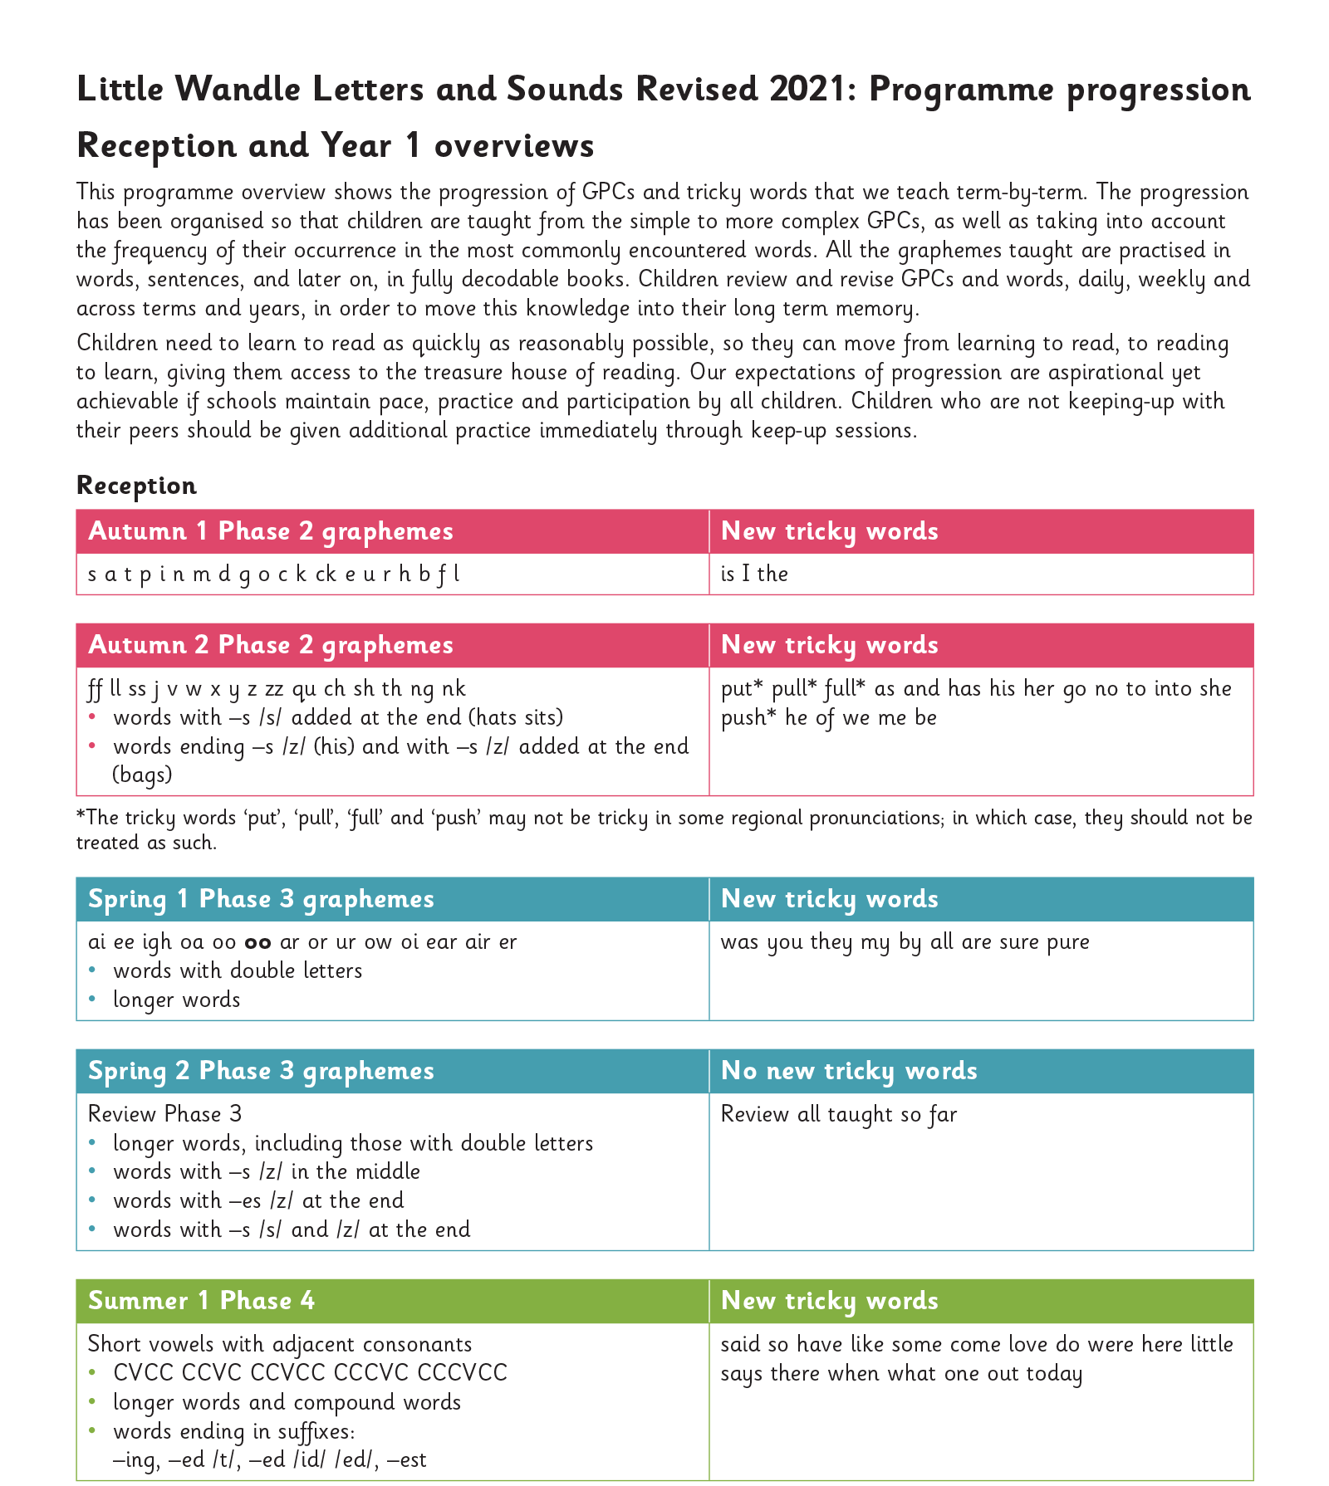
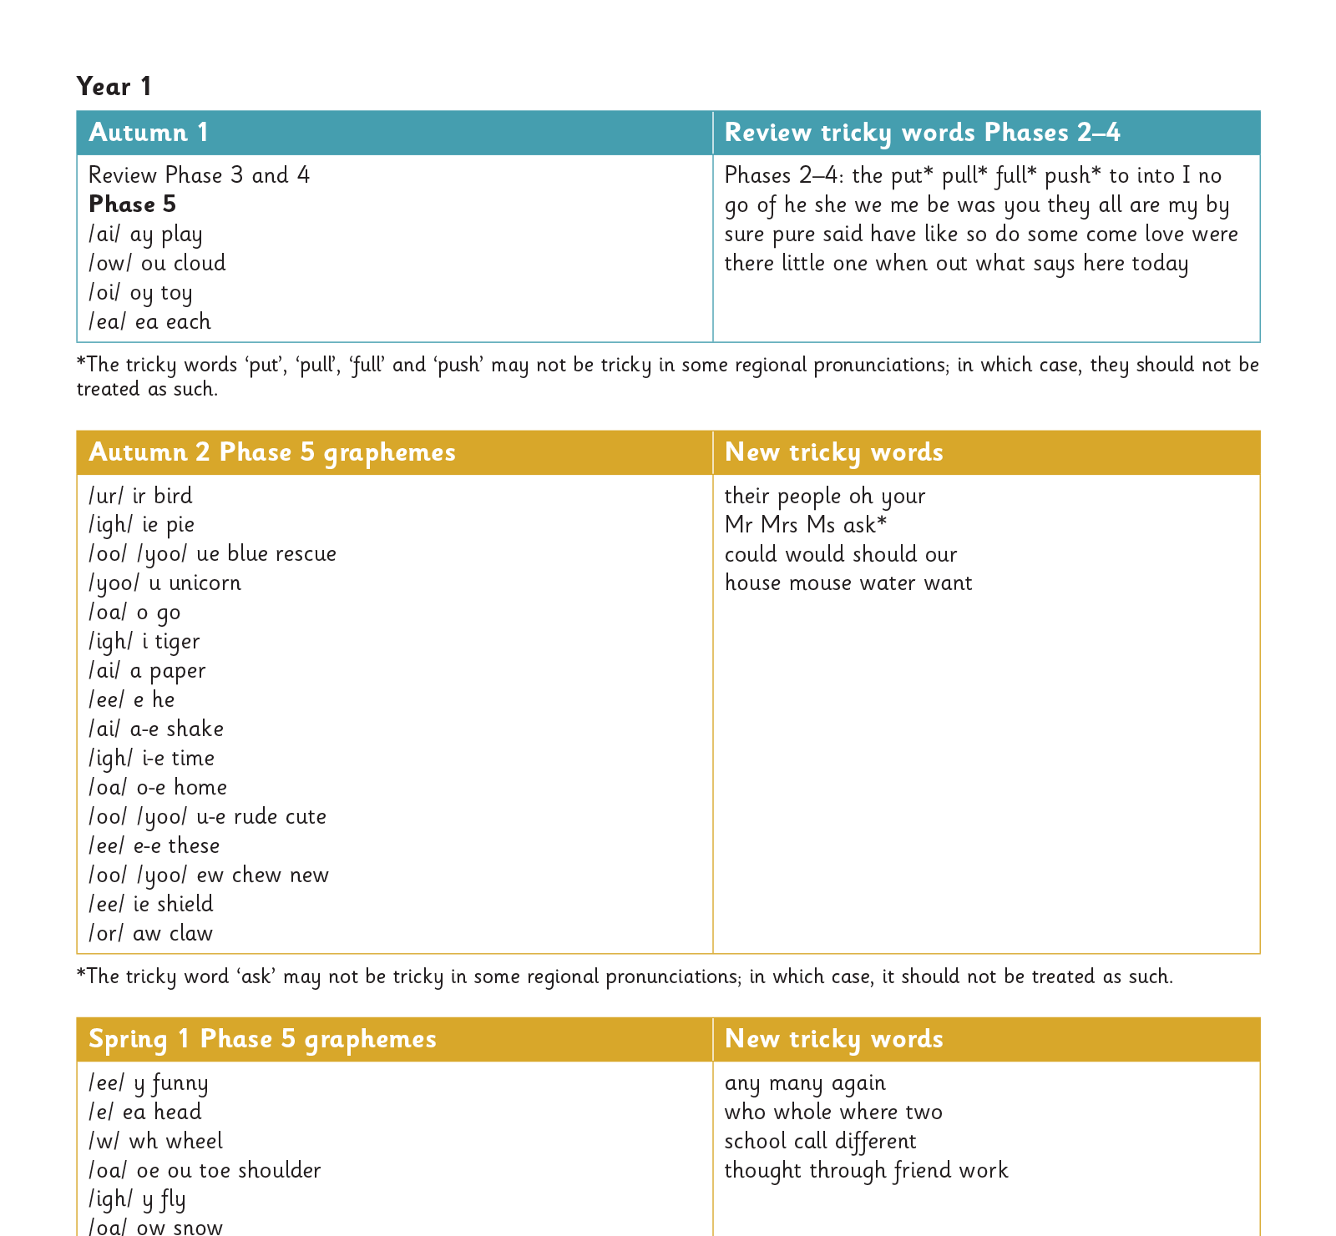
The progression
Notes:
Slide purpose:
To provide an overview of the progression children have made.
Suggested script
Your child has now learned most of the phonics progression.

Slide 5
What your child been taught so far
Your child has been taught most of Phase 5, they know:
new graphemes for the Phase 2 and 3 sounds
that the same grapheme can have alternative pronunciations.
The ‘Grow the code’ lessons support children with reading and spelling these alternative spellings.
Notes:
Slide purpose:
To provide an overview of Phase 5 'Grow the code'
Suggested script:
The children learn the last set of graphemes, including ones with alternative pronunciations.
Play the video which explains how we teach Phase 5. (The first 20 seconds repeats the ‘How to say the sounds’ video but then goes on to explain what the alternative graphemes are for the sound /ai/).
Children will also learn to ‘grow the code’ and will explore different ways of spelling the same phoneme and reading the same grapheme.
Children learn strategies so that they can distinguish between the same grapheme but different phoneme and the same phoneme but different grapheme. ‘Growing the code’ will support children as they get older with accurate spelling.

Slide 6
Phonics Screening Check

Slide 7
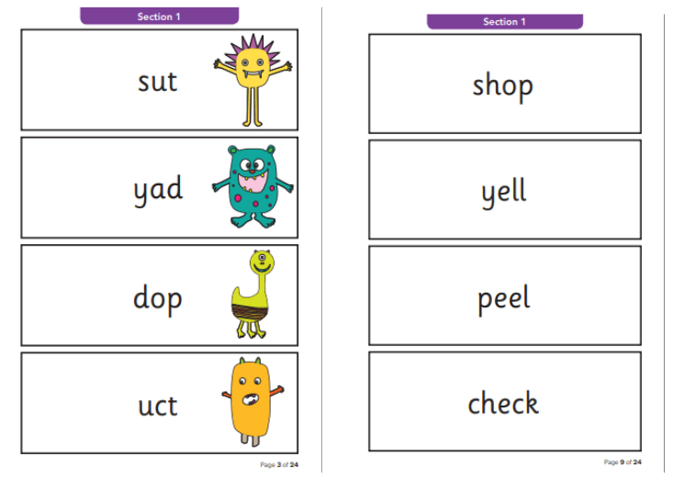
This term we are preparing for the Phonics Screening Check
What is the Phonics Screening Check?
It is a quick check of your child’s phonics knowledge.
It is not designed to create any stress or anxiety for your child.
It assesses decoding skills using phonics.
It consists of 40 words (20 real words, 20 ‘alien words’).
If children do not achieve the required score in Year 1, they will retake the screening at the end of Year 2.
Notes:
Slide purpose:
To introduce the Phonics Screening Check.
Suggested script:
Read the slide.

Slide 8
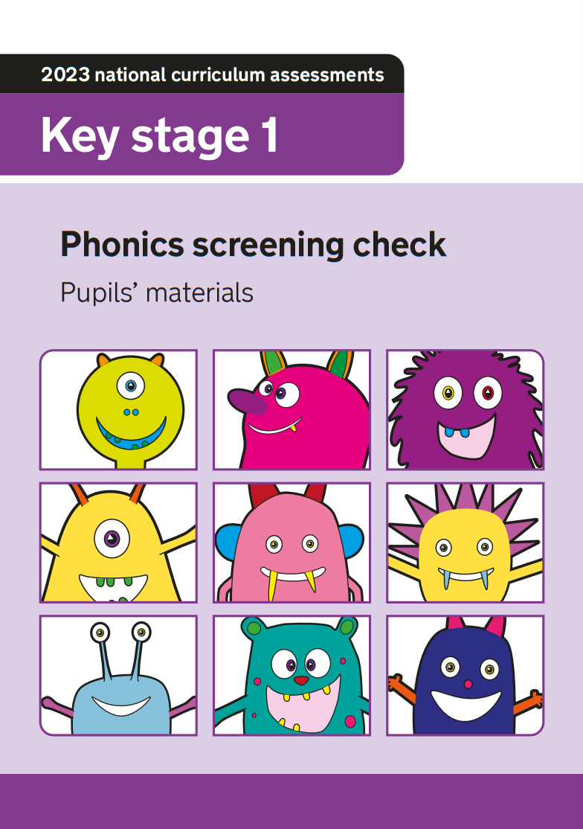
How does the check work?
Your child will sit with a member of staff that they know.
They will be asked to read 40 words aloud.
This takes just a few minutes to complete, but there is no time limit.
If your child is struggling, the teacher will stop.
It has been carefully designed not to be stressful for your child.
Notes:
Slide purpose:
To provide an overview of the Phonics Screening Check.
Suggested script:
Staff will use their judgement on whether they feel children need a break from reading the 40 words.
If staff feel that the check is too much, they will stop.

Slide 9
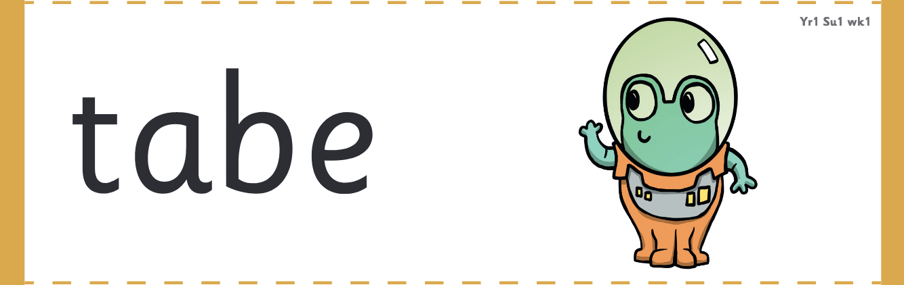
‘Alien words’ recap
The check will contain 20 ‘alien words’.
The children will be familiar with alien words and will start to read them this term.
Alien words assess children’s decoding skills and are used in lessons for the purpose of preparing for the Phonics Screening Check only.
Children cannot read these words by using their memory or known vocabulary, so they have to use their decoding skills. This is a fair way to assess their ability to decode.
The Phonics Screening Check will be administered in June.
Notes:
Slide purpose:
To provide an overview of ‘alien’ words
Suggested script:
A lot of the phonics curriculum is now focusing on getting children to read fluently. However, we will teach children to only sound and blend alien words. This is because we want children to be accurate – speedy doesn’t always do it!

Slide 10
Reading at home

Slide 11

The most important thing you can do is read with your child
Reading a book and chatting had a positive impact a year later on children’s ability to…
understand words and sentences
use a wide range of vocabulary
develop listening comprehension skills.
The number of books children were exposed to by age 6 was a positive predictor of their reading ability two years later.
Parental involvement in the development of children’s reading skills: A five-year longitudinal study (2002) Senechal, M. and Lefvre, J
Notes:
Slide purpose:
To introduce the values of reading at home.
Suggested script:
You play a crucial part in your child's reading and the most important thing you can do is read with them.
Read the slide.
Celebrate child’s success at school.
Make time for reading at home!

Slide 12
Listening to your child read their phonics book
Your child should be able to read their book without your help.
If they can’t read a word read it to them.
Talk about the book and celebrate their success.
Notes:
Slide purpose:
To give guidance on reading the decodable book at home.
Suggested script:
Children shouldn’t find reading their phonics book hard!
We want them to bring a book home that they can read mostly fluently.

Slide 13

Read to your child
The shared book is for YOU to read:
Make the story sound as exciting as you can by changing your voice.
Talk with your child as much as you can:
Introduce new and exciting language.
Encourage your child to use new vocabulary.
Make up sentences together.
Find different words to use.
Describe things you see.
Notes:
Slide purpose:
To give guidance on reading the shared book at home.
Suggested script:
Reading to your child daily can open a variety of doors to your child's education, imagination and well-being.
Read the slide.
As a school, we also prioritise reading to the children daily to encourage the love of reading.

