Slide 1



Welcome!
Curriculum Meeting for Parents of Children in Year 3

Slide 2

Year 3 Team
Class 7 – Mr Mullins
Class 8 – Mr Freeman and Mrs Locke

Slide 3

Topics
Autumn | Spring | Summer
DT – Roman Mosaics History - The Stone Age Science – Rocks and Forces | Art - Vincent Van Gogh DT - Food History – The Romans Science – Human Body and Plants | Art – Escher DT – Mechanism and Levers Geography – Magnificent Mountains and Spectacular Britain Science - Light

Slide 4

Reading
Reading is an important part of our weekly learning, and we focus on developing a range of skills through:
Comprehension activities, including:
  Reading aloud
  Summarising texts
  Using dictionaries to explore vocabulary
  Retrieving and inferring information from what they read
Children will also have access to reading books and library books to support their progress.
At home, please aim to read with your child at least three times a week and record this in their reading record.
In school:
Your child will complete a weekly reading activity on the iPad allocated to them.
We aim to read individually with your child once a week, in addition to:
  Guided reading sessions
  Whole class story time

Slide 5
Reading
Comprehension
- Reading aloud
  - Summarising
  - Dictionary
  - Retrieve and infer information
Reading books and library books
Please read with your child at least 3x a week and record this in their reading record.
iPad reading – your child will complete a reading activity weekly.
We aim to read with your child once a week in addition to iPad reading and guided reading
Whole class story time

Slide 6
Writing
In writing, we will explore different writing genres over the course of the year. At the end of each genre, we will create our own piece.
We will identify the features of each genre and embed Year 3 grammar within each genre.
Autumn term genres:
Narratives
Handwriting – practising the school’s cursive script and formation of letters correctly.
write for a range of purposes
use paragraphs to organise ideas
in narratives, describe settings and characters
in non-narrative writing, use simple devices to structure the writing and support the reader (e.g. headings, sub-headings, bullet points)
use capital letters, full stops, question marks, commas for lists and apostrophes for contraction mostly correctly
spell correctly most words from the year 3 / year 4 spelling list, and some words from the year 5 / year 6 spelling list*
write legibly. (1)

Slide 7
Handwriting
Children will practice the school’s cursive script and formation of letters correctly. We have two sessions of Handwriting per week, with the potential of applying their joins into words. It will also be applied across the curriculum.
We ask parents to further practice their skills at home, in their homework, to ensure plenty of repetition and therefore retention.
We want the children to take great pride in their work, so we will also be ensuring presentation is the best of their ability. Every work is better than the last. Children will be asked to use a ruler to draw lines, use their red (for marking) and purple pens (for polishing).

Slide 8
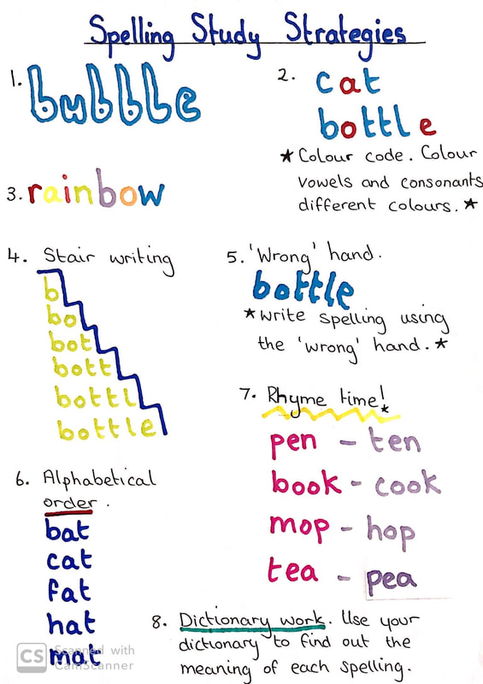
Spelling
Children will do a weekly spelling test every Friday, which will be practiced in lessons and in their homework. They will also do a SACAWAC every morning. They will get one of these sheets as part of their homework on Fridays for them to learn them at home. There are roughly 2 spelling lessons per week. Lesson 1 will be introduction of the spelling sound or rule, whereas Lesson 2 will be work based on the rule/sound in their books or orally.

Slide 9
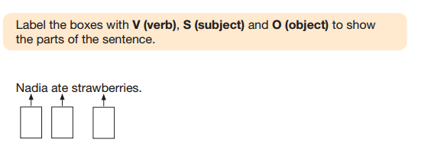
Grammar
Each week, children will take part in a dedicated grammar lesson focusing on key elements of sentence structure and vocabulary.
Topics include:
Types of sentences (e.g. statements, questions, commands, exclamations)
Parts of a sentence (such as subject, verb, and object)
Vocabulary development, including:
  Coordinating conjunctions (e.g. and, but, or)
  Adverbs (e.g. quickly, often, silently)
  Prepositions (e.g. under, between, during)

Slide 10
Grammar
Weekly Grammar lesson
Types of sentence
Parts of a sentence
Vocabulary e.g.: coordinating conjunctions, adverbs, prepositions

Slide 11

Maths
Five 1hr mathematic lessons each week, including an Arithmetic lesson.
Throughout the Autumn Term we cover:
  Place Value, Addition and Subtraction, Multiplication and Division
Maths skills
Times tables (33 Club/TTR)

Slide 12


Maths
There are 5 Maths lessons each week, one of which being an Arithmetic lesson. Children will also engage in a weekly Maths skills.
Our focus of the Autumn Term will be Place Value as well as Addition and Subtraction, Multiplication and Division. They will engage in questions on paper and on IXL or Maths.co.uk depending on the context. We ask that the children frequently practice their IXL Diagnostic. See next slide for more information:

Slide 13
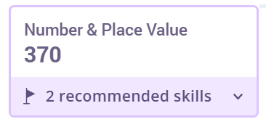
Maths - IXL
They will have an iPad allocated to them in Year 3, but they will likely need frequent practice at home.
When children load up their IXL, they need to check their diagnostic. Children in Year 3 need to be working between 300 and 400 in each skill. Click on the stadium for recommendations.
We ask parents to not give them the answers but allow them to work through it independently.

Slide 14
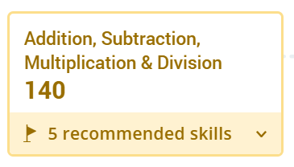
Maths
Children will have lots of practice to explore their timetables in Year 3 in preparation for the Year 4 Timetables Check.
Click on the skill (see right) for further practice on IXL.
They will do a weekly 33 club, in which they have relevant number of questions or timetables suitable to them.
Timetables Rockstars will be available for them
to practice their timetables.

Slide 15
PE
Please ensure your child comes to school wearing the correct PE kit on their PE days:
Class 7 – Monday (outdoor) and Tuesday (indoor)
Class 8 – Thursday (outdoor) and Friday (indoor)
The PE kit should include: Black shorts (not short shorts) or jogging bottoms, yellow T-shirt and trainers or daps.
For safety reasons, earrings (studs) must be either removed or securely taped before school.
If your child is unable to take part in PE due to a medical reason, please send a note or email to their teacher. Otherwise, they will be expected to participate.

Slide 16
Other Curriculum Subjects
RE - taught weekly, starting with ‘The Creation Story’
PSHE – taught weekly, starting with ‘Being in My World’
Computing – taught sporadically, usually rotated with French.
Music – recorders

Slide 17
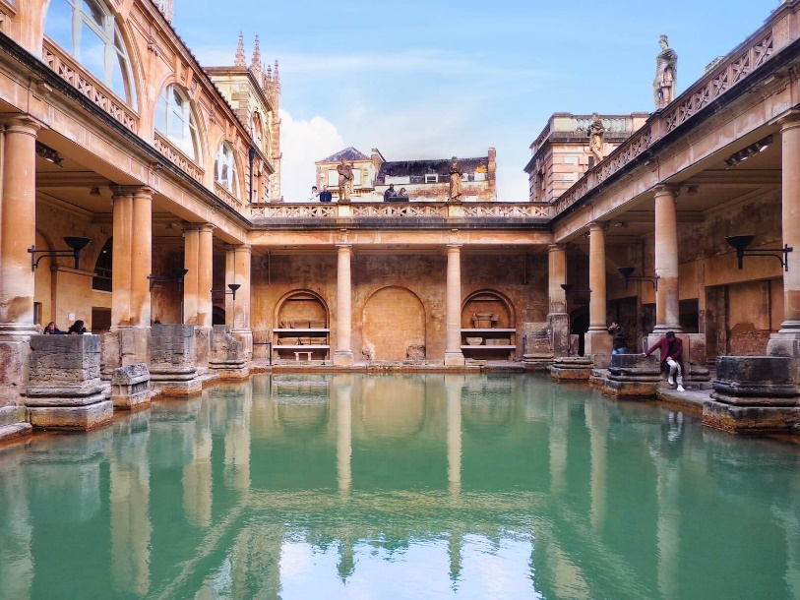
Our Trip
This year our trip will be to the Roman Baths – link to our history unit.
Our trip will be in the spring term.

Slide 18

Routines and Expectations - Homework
Homework will be set every Friday and should be returned completed by the following Wednesday.
This year, we’re introducing a new homework format, which includes:
Maths
Handwriting
SACAWAC (Study And Cover And Write And Check – a spelling strategy)
In addition to the set homework:
Times Tables Rockstars (TTR) practice is strongly encouraged.
Reading should be done regularly throughout the week — aim for at least three times.
Spellings will be sent home to learn and should be practised during the week in preparation for the spelling test on Thursday.

Slide 19
General Reminders
Children should bring their reading book into school everyday.
Water bottles (clearly named and containing only water) should be brought into school.
As we move into the Autumn Term, please ensure your child has a coat (with a hood and clearly named) with them every day.
Uniform: no trainers, no hooped earrings, hair tied back.

Slide 20
Questions
If you have any questions, please contact us on the class email addresses below:
Mr Mullins class07@holytrinity.bwmat.org
Mr Freeman class08@holytrinity.bwmat.org

